Slide 1
Chapter 9
Rotational Dynamics

Slide 2
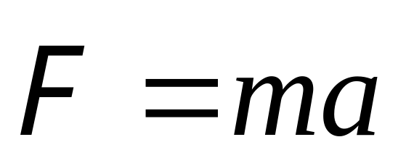
Force and Motion
The force is an interaction between
a body and its environment.
The force acting on a body
will accelerate it
How about the Force and Rotation

Slide 3

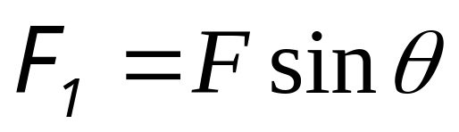
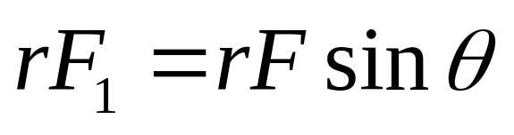
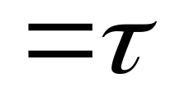
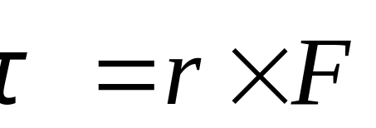

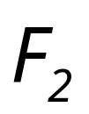



Torque
o
θ
r
m
mg
o
r
θ
m
mg

Slide 4
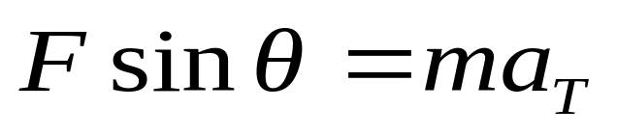

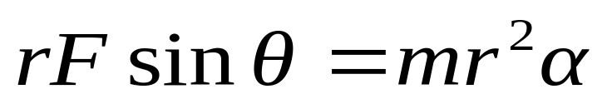
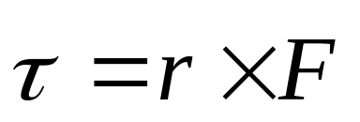
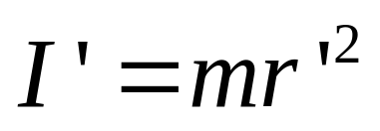
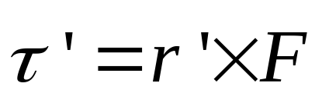
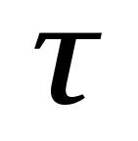

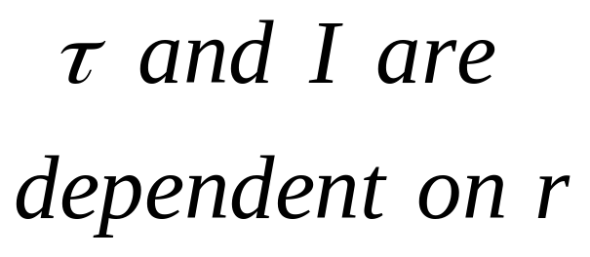
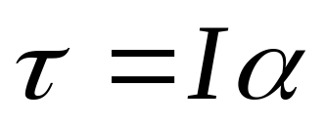
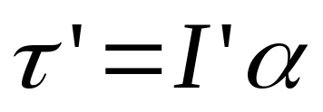
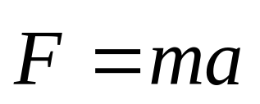
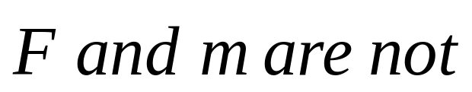
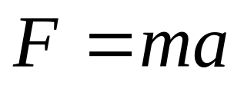
Rotational inertia and Newton’s law
Rotational inertia and Newton’s law
A single particle
y
F
y’
Fsinθ
θ
m
r’
I
x’
O’
We define quantity mr² to be the rotational inertia I of the particle:
x
Rotational motion
τ = Iα
Linear motion

Slide 5
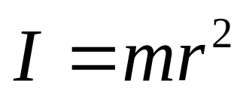
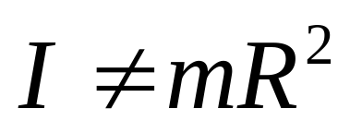
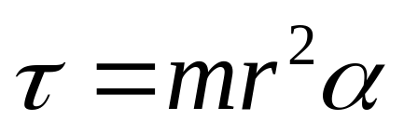




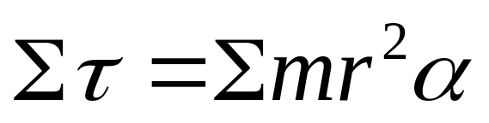
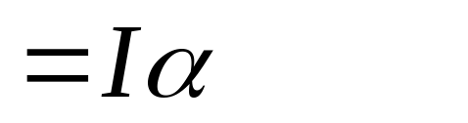

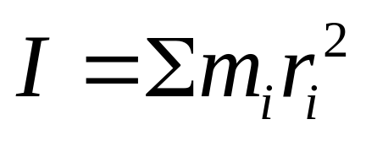
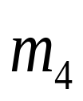
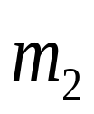

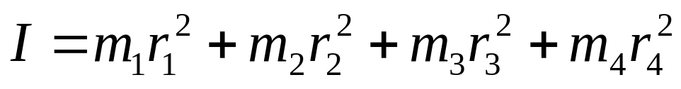

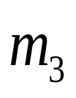
The rotational inertia depends on the mass of the particle and on the perpendicular distance between the particle and the axis of rotation.
Many particles system

Slide 6
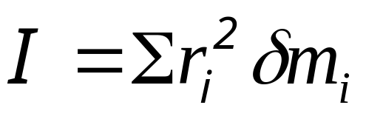
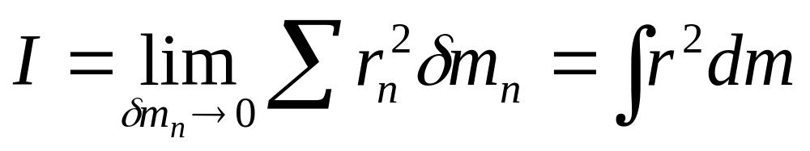
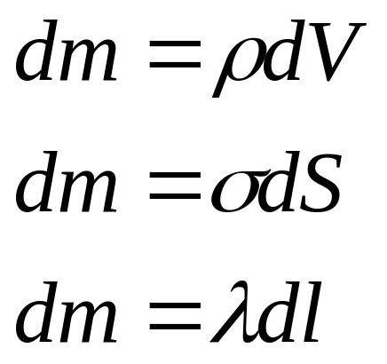
Rotational inertia of solid bodies

Slide 7
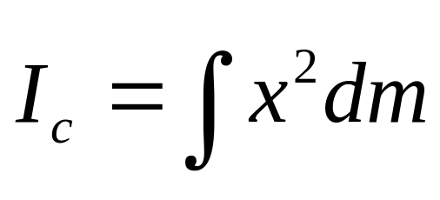
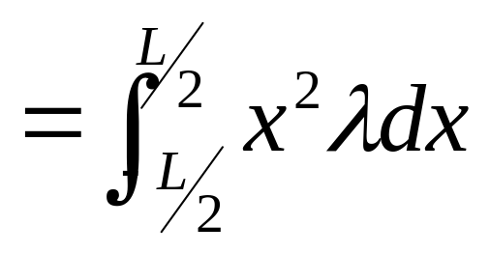
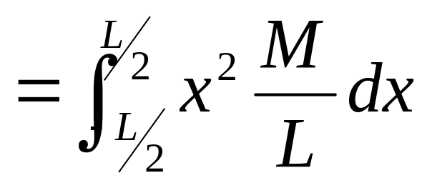
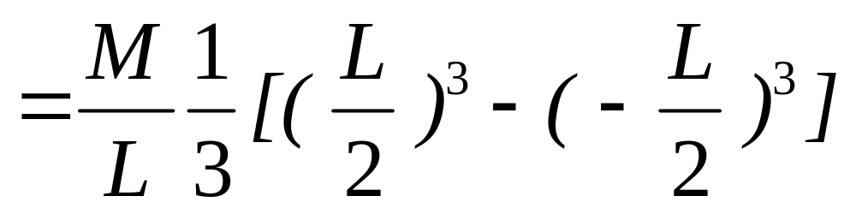
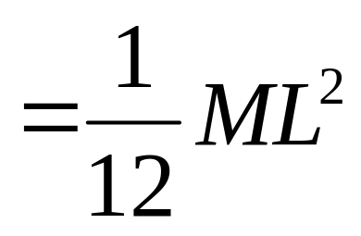
z
A thin rod with mass M, it is uniform density ρ, and length L rotate about z axis through the center of mass.
Example
x dx

Slide 8
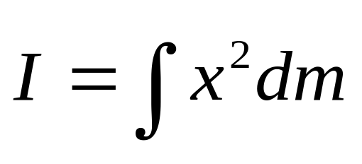
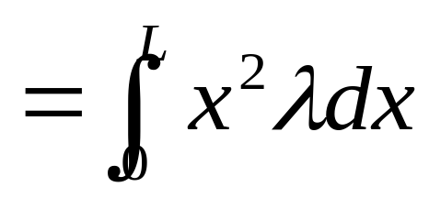
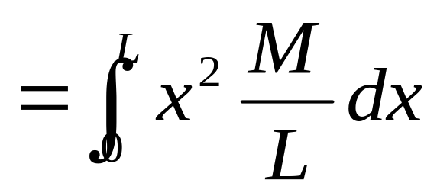
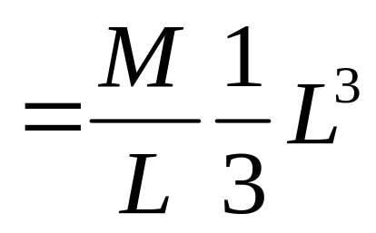
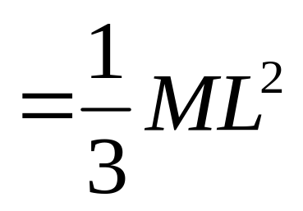
Example
z
If the axis through the one end of the rod perpendicular to length in parallel with axis through the center of mass.
dm
x dx

Slide 9
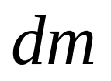
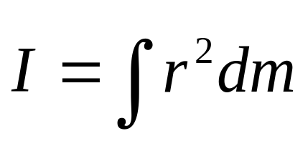
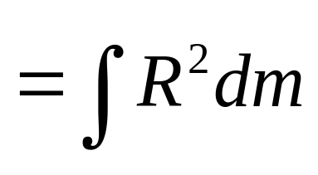
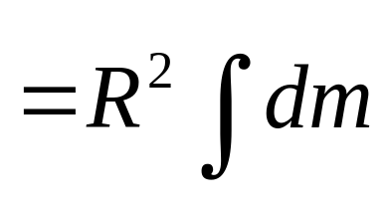
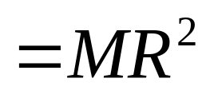
z
Example
A ring with redium R, and mass M rotates about z axis perpendicular to the plate.
R

Slide 10
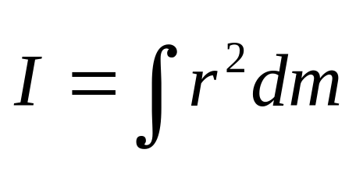
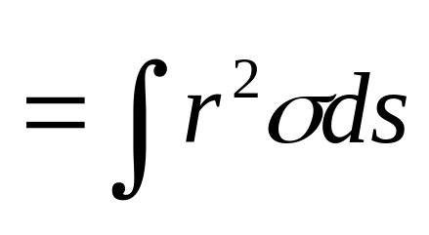
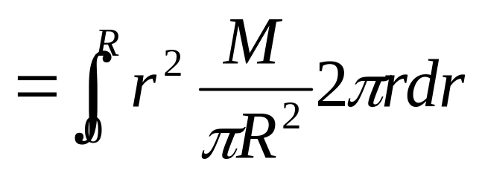
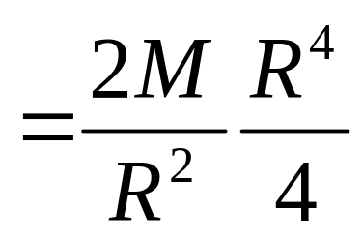

z
Example
A merry-go-round with redium R, and mass M rotate about z axis perpendicular to the plate.
r dr
R

Slide 11




z
Example
A thin spherical shell with redium R, and mass M rotate about z axis.
θ
dθ

Slide 12




z
Example
dr
A solid sphere with redium R, and mass M rotate about z axis.
r

Slide 13




z
Example
A solid sphere with redium R, and mass M rotate about z axis.
R
θ

Slide 14



rod
ring
cylinder
shell

Slide 15

disk
cylinder

Slide 16


thin spherical shell
solid sphere

Slide 17











The parallel-axis theorem
y
y’
rotate about y’ axis
rotate about y axis
R
c
o
r_{n}’
r_{n}
m_{n}
I = MR² + I_{cm}

Slide 18


y’
y

Slide 19



rod

Slide 20




The perpendicular-axis theorem
z
rotate about z axis
y
rotate about x axis
o
I_{z} = Σ (x_{n}²+y_{n}²) m_{n}
r_{n}
m_{n}
y
I = Σ x_{n}²m_{n} +Σ y_{n}²m_{n}
x
I_{z} = I_{y}+ I_{x}

Slide 21









Mass center
Rotational inertia

Slide 22



rod

Slide 23




A rigid system with many particles
z
perpendicular distance is r_{i},
external force F_{i}
f_{i}
F_{i}
internal forces f_{i}.
r_{i}
o
m_{i}
For the particle i
For all particles

Slide 24










A rigid system with many particles
z
f_{i}
F_{i}
r_{i}
o
For all particles

Slide 25


A rigid system with many particles
z
f_{i}
F_{i}
r_{i}
o
For all particles

Slide 26






A rigid system with many particles
z
f_{i}
F_{i}
r_{i}
o
For all particles

Slide 27
CHAP. 9
Exercises
13, 14 (P200)
17, 19, 21 (P201)

Slide 28








One particle
Many particles

Slide 29











Force of gravity
m_{n}
c
r_{n}
m_{n}g
r_{cm}
Mg
cm frame
A usuful corollary: the torque due to gravity about the center of mass of a body is zero.

Slide 30









Torque from pseudoforce
Same as torque due to gravity
m_{n}
m_{n}a
r_{n}
a
The center of pseudoforce coincides with the center of mass

Slide 31













Applications of Newton’s law for rotation
Fine the acceleration of the blocks, the tension in the cord and the angular acceleration of the disk.
Example
m, R
a
T₁
T₂
m₂
a
m₁
m₂g
m₁g

Slide 32








Example
A rod, mass m and length l, can rotate about point o. The rod rotates from the rest. When it is θ to horezontal, find (1) α; (2) ω; (3)a_{cm}; (4) N_{x}N_{y}.
N_{y}
l
N_{x}
o
θ
mg

Slide 33







Example
A rod, mass m and length l, can rotate about point o. The rod rotates from the rest. When it is θ to horezontal, find (1) α; (2) ω; (3)a_{cm}; (4) N_{x},N_{y}..
N_{y}
l
N_{x}
o
θ
mg

Slide 34


Example
A rod, mass m and length l, can rotate about point o. The rod rotates from the rest. When it is θ to horezontal, find (1) α; (2) ω; (3)a_{cm}; (4) N_{x},N_{y}..
N_{y}
l
N_{x}
o
θ
mg
When θ=0⁰

Slide 35


Example
A rod, mass m and length l, can rotate about point o. The rod rotates from the rest. When it is θ to horezontal, find (1) α; (2) ω; (3)a_{cm}; (4) N_{x},N_{y}..
N_{y}
l
N_{x}
o
θ
mg
When θ=0⁰
When θ=90⁰

Slide 36











Condition of Equilibrium

Slide 37

Condition of Equilibrium

Slide 38

Condition of Equilibrium

Slide 39

Condition of Equilibrium

Slide 40











Condition of Equilibrium

Slide 41



Slide 42





θ

Slide 43


Combined rotational and translational motion
The center of mass of the object moves translational motion.
The motion of any other point of object is a complicated combination of the rotational and translational motion.
ω
Σ F_{ext}=ma_{cm}
c
ω×r’_{ic}
v_{cm}
Σ τ_{ext}= Iα
r’_{i}

Slide 44
plane parallel motion
Now we restrict our discussion of this combined motion to cases satisfying two conditions: (1) the axis of rotation passes through the center of mass, and (2) the axis always has the same direction in space. We call this motion as plane parallel motion.

Slide 45







Rolling without slipping
v
A
P
v
ω
ω
v_{cm}
v_{cm}
v_{cm}
B
There is not relative motion at the point of contact.
the condition of rolling without slipping.

Slide 46













Example
N
A solid cylinder of mass m and radius R rolls without slipping down an inclined plane with angle θ. Find the a_{cm} and f.
f
a_{cm}
mg
motion of the center of mass:
For the rotational motion of the cylinder about the axis
Rolling without slipping.
If not, the cylinder may be slipping.
μ_{s}=0, it is complete slipping (no rotate)

Slide 47
Rolling without slipping
v
A
P
v
ω
ω
v_{cm}
v_{cm}
v_{cm}
B
There is not relative motion at the point of contact.
the condition of rolling without slipping.
About B point
Instantaneous axis

Slide 48





N
Example
C
A solid cylinder of mass m and radius R rolls without slipping down an inclined plane with angle θ. Find the a_{cm} and f.
f
a_{cm}
B
mg
About C or B?

Slide 49

Rolling about different axis is same

Slide 50
CHAP. 9
Exercises
33, 38 (P203)
41, 42, 43 (P204)

